Slide 1
Covid Database
Project by Brandon Kaplan & Ed Botterbusch

Slide 2

The Key of The Database- Julia
Can Access C libraries and
Special Computation Libraries for
Complex math functions including
Diff Eq functions.
-Automatic Memory Management
-The Foster Child of Python and C

Slide 3
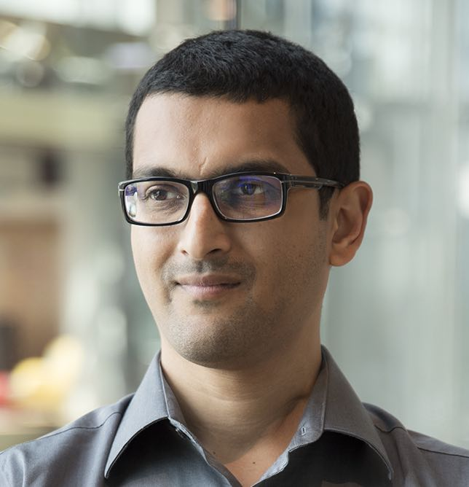
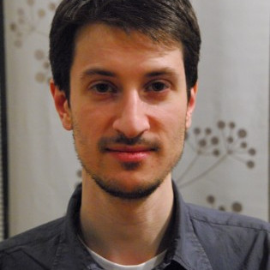

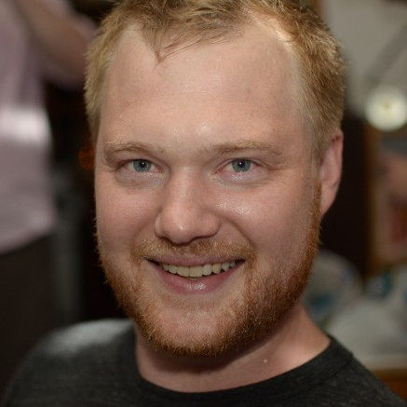
History to Modern Usage
-Founders: (Top-Left: Dr. Viral B. Shah,
Top Right: Dr. Jeff Bezanson ,
Bottom Left:: Prof. Alan Edelman,
Bottom-Right:Stefan Karpinski)
– Initial vs Recent
- -Overall Prevalence

Slide 4
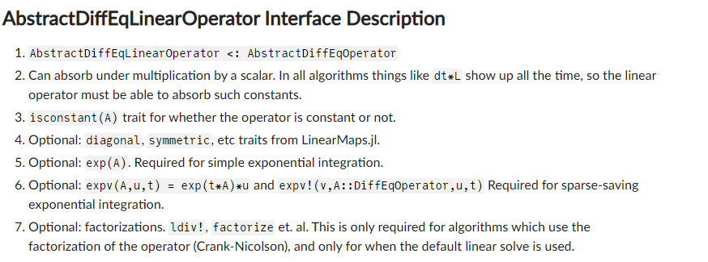

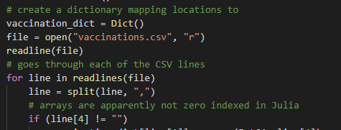
Crash Course of Julia
-Provide Functions For Complex
Math & Speciality Abilities
-Similarities To Python/Matlab
Syntax

Slide 5
Opinions & Hopes In The Future
How we felt about learning Julia
How useful we think the language is
How Julia compares to other languages.
Our Recommendations
Future Aspirations With Julia

Slide 6
Works Cited
https://julialang.org
https://www.analyticsvidhya.com/blog/2020/08/what-is-better-for-data-science-learning-and-work-julia-or-python/
https://en.wikipedia.org/wiki/Julia_(programming_language)
https://www.hpcwire.com/off-the-wire/julia-computing-raises-24m-series-a-former-snowflake-ceo-bob-muglia-joins-board/
https://cheatsheets.quantecon.org/

